Slide 1
Digital Portfolio
STUDENT NAME: Richerd Immanuel A
REGISTER NO AND NMID: 24132011802521081 and asanm20124132011802521081
DEPARTMENT: Computer Science
COLLEGE:Arignar Anna Govt.Arts College/ Annamalai University

Slide 2
PROJECT TITLE
Digital portfolio

Slide 3


AGENDA
Problem Statement
Project Overview
End Users
Tools and Technologies
Portfolio design and Layout
Features and Functionality
Results and Screenshots
Conclusion
Github Link
3/21/2024 Annual Review

Slide 4

PROBLEM STATEMENT
Traditional resumes fail to highlight
skills effectively; a digital portfohio
provides an interactive solution.

Slide 5

PROJECT OVERVIEW
The digital portfolio is an online platform to
display skills, projects, and achievements.It
enhances personal branding and makes
information easily accessible.

Slide 6

WHO ARE THE END USERS?
The end users of a digital portfolio are
students, job seekers, and professionals.
Recruiters, employers, and academic
evaluators also use it for assessment.

Slide 7

TOOLS AND TECHNIQUES
The digital portfolio is
developed using HTML, CSS,
and Javascript for design and
interactivity.

Slide 8
POTFOLIO DESIGN AND LAYOUT
The digital portfolic follows a clean and
responsive layout with sections like Home,
About Me, skils, Projects, and Contact. A
simple navigation bar.
8

Slide 9
FEATURES AND FUNCTIONALITY
Pour digital portfolio shows a blue themed webpage
with a header, footer, and sections like About, Skills,
Projects,Contact.lt [ooks neat, interactive, and
highfights personal details and work.

Slide 10
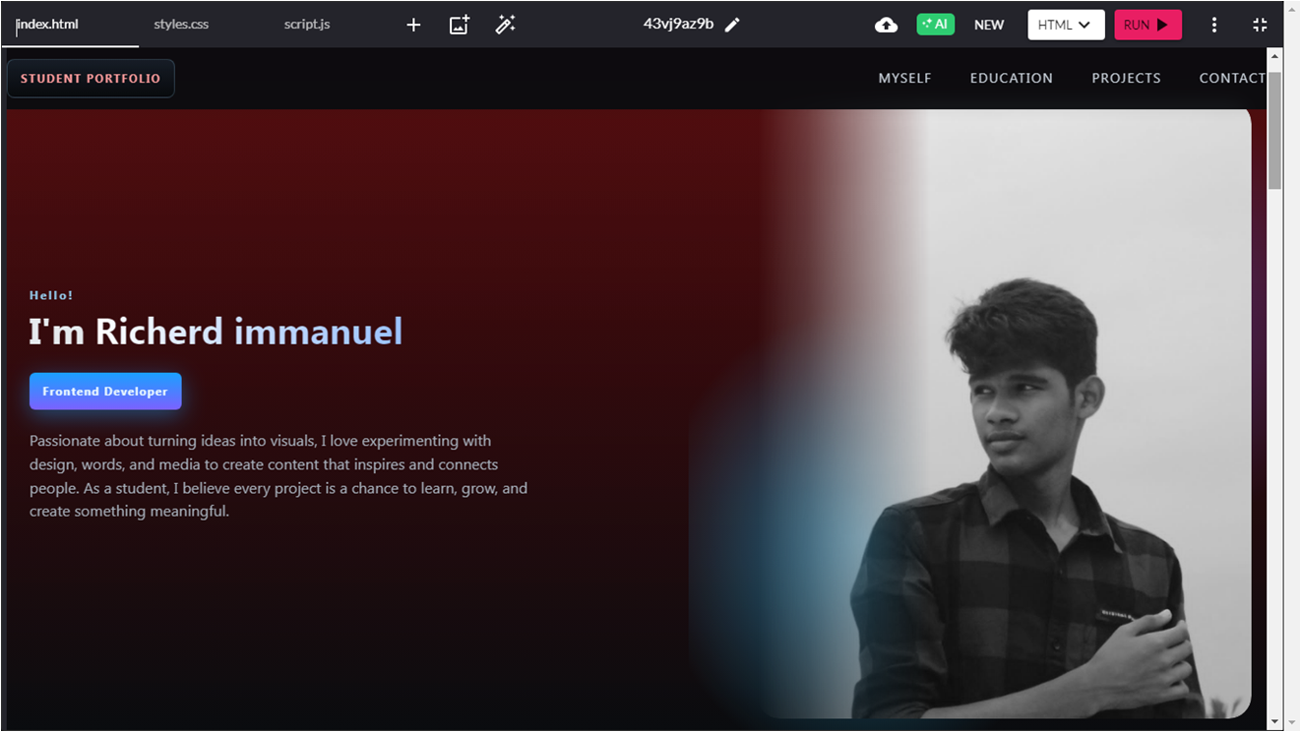
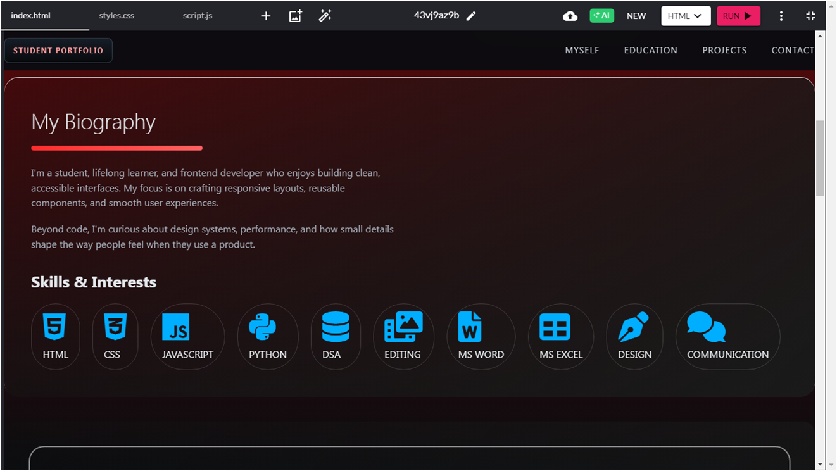
RESULTS AND SCREENSHOTS
3/21/2024 Annual Review
10

Slide 11
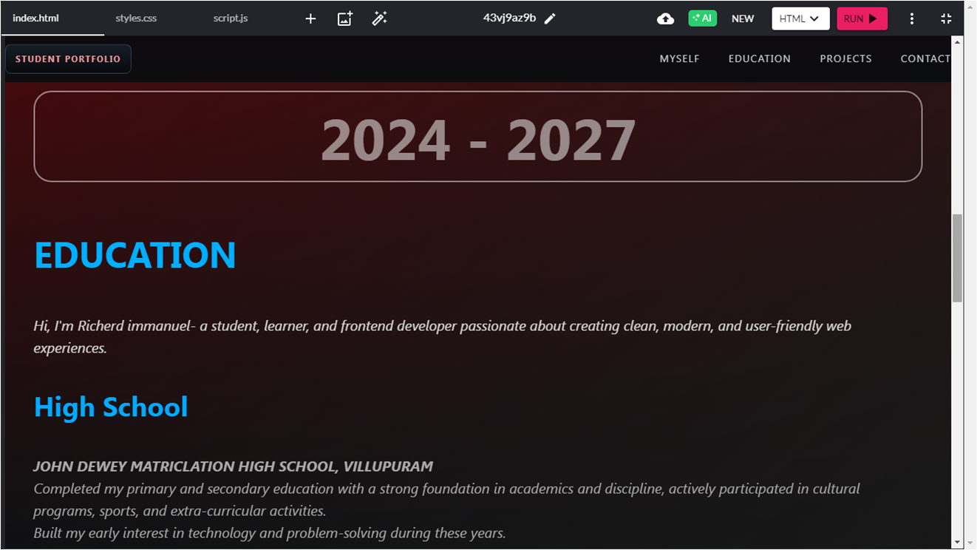
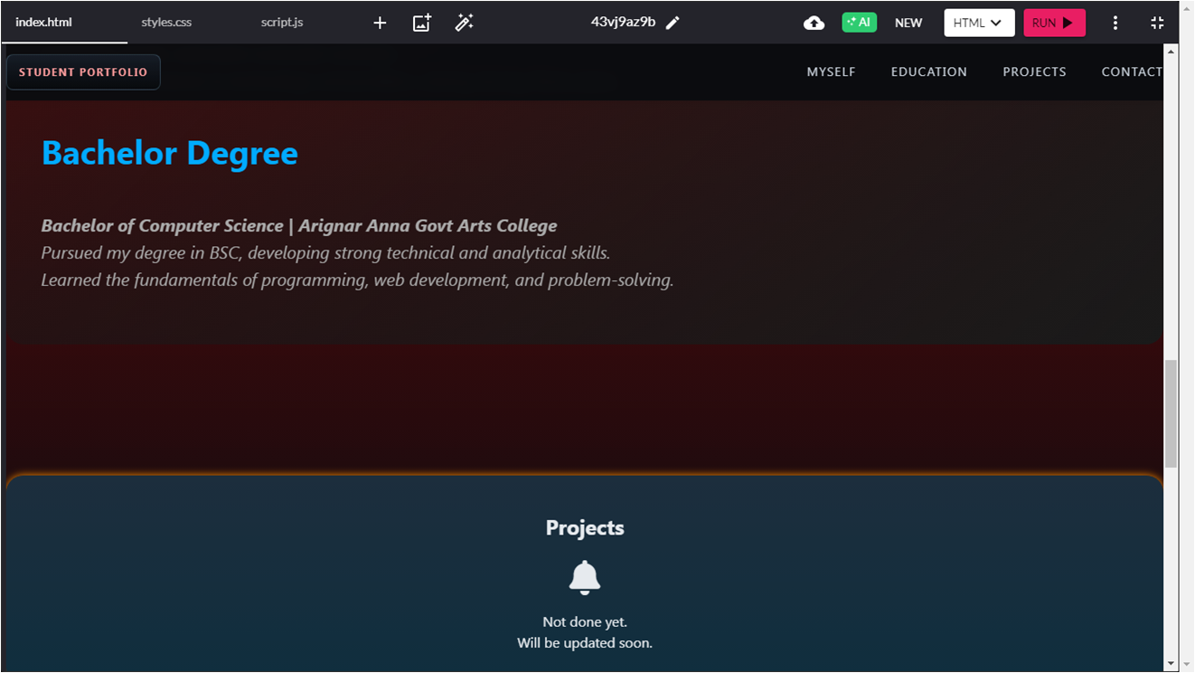
RESULTS AND SCREENSHOTS
3/21/2024 Annual Review
11

Slide 12
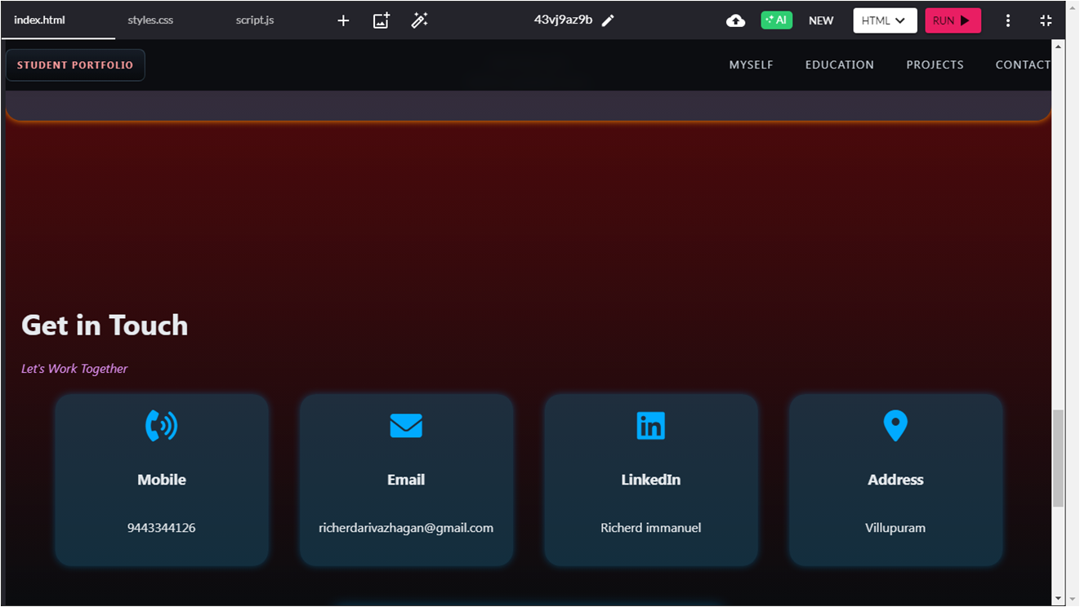
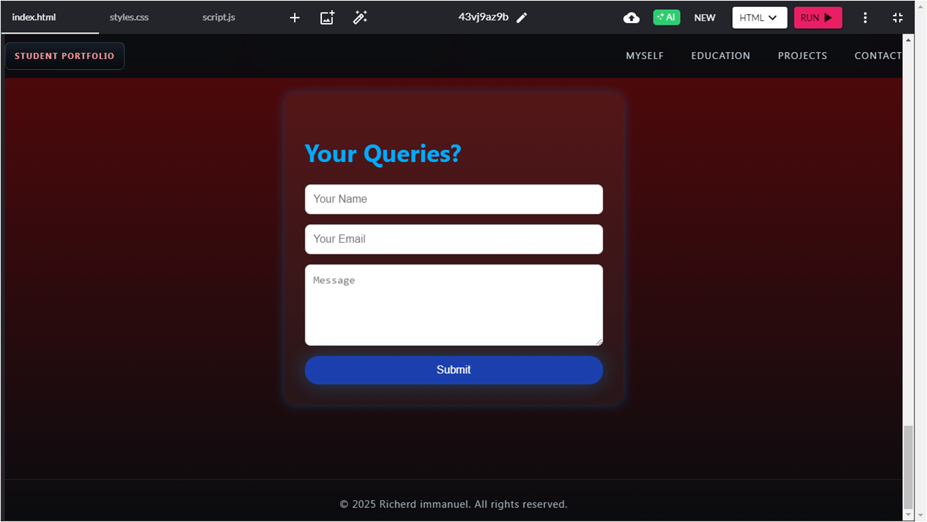
RESULTS AND SCREENSHOTS
3/21/2024 Annual Review
12

Slide 13
CONCLUSION
The digital portfolio includes
sections for skills, projects, and
contact details. It offers responsive
design, easy navigation, and
accessibility across devices.
13

